Slide 1
Rise to Your Purpose

Slide 2
Isaiah 14: 26-27
²⁶ This is the purpose that is purposed on the whole earth, and this is the hand that is stretched out on all the nations. ²⁷ For the Lord of Hosts has purposed, and who shall disannul it? And His hand is stretched out, and who shall turn it back?

Slide 3
Proverbs 29:18
“Where there is NO VISION, the People Perish”
A People without a Vision –
A People who have No Purpose -
is a People that will soon die

Slide 4
Too Often – We want the Results of Someone’s Vision
WITHOUT PAYING THE PRICE REQUIRED

Slide 5
Purposes in the Mind of People and in the Mind of God
Are the KEYS
to all Progress in life

Slide 6
Some key purposes in Scripture
Good works : Eph 2:10
Salvation : 2 Tim 1: 9
Reconciliation : Eph 2: 14-16
Co-workers in God’s harvest field: 1 Cor 3: 7-9
To be a Blessing : Heb 6:13-17

Slide 7
Which Response do we build on?
Luke 6: 48 : “…well built”
Or
Luke 14: 29 : “…not able to finish it”

Slide 8
1 Cor 3: 10 “…I laid a foundation as a wise builder, and someone else is building on it. But each one should build with care”

Slide 9
The Wealth of a Nation
Is Measured only
In the Men and Women
That a Nation Possesses

Slide 10
The FAITH, CHARACTER, DREAMS of these Purposed and Committed men and women
Will Determine the Success of the Kingdom of God

Slide 11
The Wealth of God’s Kingdom is
Determined by the Kind of
Purposed Godly Leaders
We Produce

Slide 12
Keys to a purposeful life – Reflect who Christ is and His purpose in you!
Thankful attitude : 1 Thess 5:18
Prayerful always : 1 Tim 2: 1-4
Living a Sanctified life: 1 Thess 4:3
Follow Christ’s example: Luke 9: 23

Slide 13
The Church Exists to Establish God’s Kingdom Values and Lifestyle by:
the message of God’s Love & Salvation
the demonstration of God’s Power to bring Transformation
Our Assignment is
Kingdom Transformation!

Slide 14
Limitations on God’s Purposes in your life
#1. A Passion for Money
#2. Overcome by Distractions
#3. Circumstances of Life

Slide 15
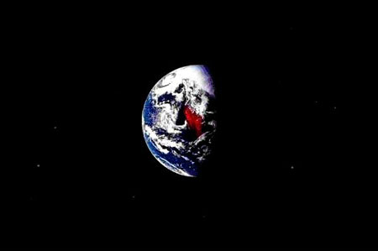
Have the right motivation!
Matt 22: 37-40
Love the Lord your God….
Love your neighbor as yourself

Slide 16
Isaiah 14: 26-27
God has Purposed
His church to work with Him to usher in His Kingdom!

